Slide 1
Introduction to Python for Data Science Section 1 - Non-Specific M.Tech AIML
BITS Pilani
Pilani|Dubai|Goa|Hyderabad
B Radhika
1

Slide 2
Agenda for CS #4,5,6
Introduction to SciPy Ecosystem
Basics of NumPy
Basics of Pandas
Data Exploration for a Bike Dataset
Visualizations using Matplotlib
Visualizations using Seaborn
Introduction to Scikit-learn

Slide 3
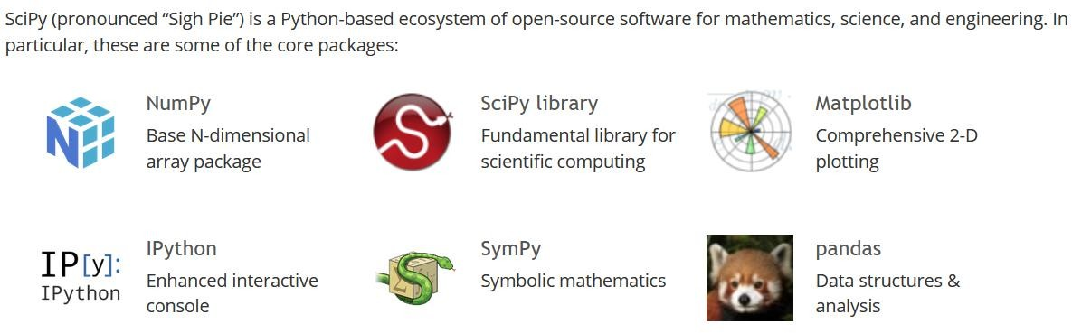
Introduction to SciPy Ecosystem
https://www.scipy.org/
https://www.scipy.org/about.html

Slide 4
NumPy
NumPy stands for Numerical Python.
NumPy is a Python library used for working with arrays.
It also has functions for working in domain of linear algebra, fourier transform, and matrices.
Why use NumPy ?
In Python we have lists that serve the purpose of arrays, but they are slow to process.
NumPy aims to provide an array object that is up to 50x faster than traditional Python lists.
The array object in NumPy is called ndarray, it provides a lot of supporting functions.

Slide 5
Pandas
Pandas is a Python library used for working with data sets.
It has functions for analyzing, cleaning, exploring, and manipulating data.
The name "Pandas" has a reference to both "Panel Data", and "Python Data Analysis“
Pandas allows us to analyze big data and make conclusions based on statistical theories.
Pandas can clean messy data sets, and make them readable and relevant.
Pandas gives us answers about the data. Like:
Is there a correlation between two or more columns?
What is average value?
Max value?
Min value?
Pandas are also able to delete rows that are not relevant, or contains wrong values, like empty or NULL values. This is called cleaning the
data.

Slide 6
Pandas
DataFrame:
A Dataframe is a two-dimensional data structure, i.e., data is aligned in a tabular fashion in rows and columns. In dataframe datasets arrange in rows and columns, we can store any number of datasets in a dataframe. We can perform many operations on these datasets like arithmetic operation, columns/rows selection, columns/rows addition etc.
In the real world, a Pandas DataFrame will be created by loading the datasets from existing storage, storage can be SQL Database, CSV file, and Excel file. Pandas DataFrame can be created from the lists, dictionary, and from a list of dictionary etc.
In simple, a dataframe is a collection of Series and a Series is a
collection of scalar values.
7

Slide 7
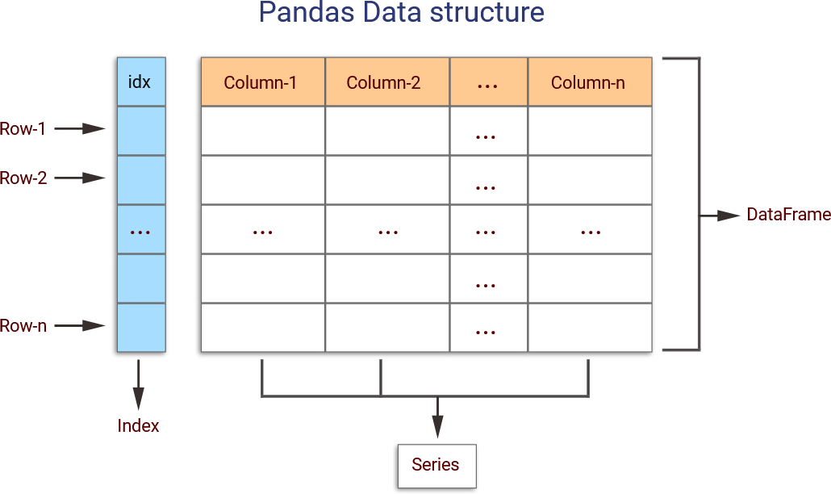
Pandas DataFrame

Slide 8
Demo on NumPy
Lets have a hands-on session on :
Creation of NumPy array
Properties of NumPy array
Prepopulated arrays
2D arrays
Ways to access array elements
Reshaping
Computations
Arithmetic
Comparison
Aggregation
Boolean
Note on Linear Algebra and NumPy arrays

Slide 9
Demo on Basics of Pandas
Importing Pandas
Series Creation
Data Frame Creation
Reading Files using Pandas
Writing to a File using Pandas
Some functions offered by Pandas

Slide 10

Post your queries in the Discussion Forum!!

Slide 11






Feedback
: 5
: 3
Thank You for your time & attention !
Contact : radhika.richy@wilp.bits-pilani.ac.in
: 1

